Slide 1
Project Presentation
Company: Gray Corporates
Name: Ritik Malviya
Internship Duration: 6 Months
Role: Data Analyst

Slide 2
Patient Data Analysis & Power BI Dashboard
1. Project Allocation and Submission Date
Project Allocation Date: 1/02/2025
Project Submission Date: 25/02/2025

Slide 3
2. Objective of the Project
The main objective of this project is to analyze patient data to extract meaningful insights using Power BI and SQL queries.
The focus is on:
Understanding patient demographics and medical history.
Evaluating diagnosis trends and treatment costs.
Identifying hospitalization patterns and follow-up appointments.
Ensuring data accuracy by validating and cleansing the dataset.
Creating an interactive dashboard to visualize patient health trends and financial impact.

Slide 4
3. Procedure of Dashboard Creation & Queries Used
Data Preparation & Validation in PostgreSQL
Data Cleaning & Transformation
Converted Full Name, Address, and Diagnosis fields into Proper Case.
Standardized Treatment Cost by converting it into a decimal format.
Replaced NULL values with appropriate placeholders (e.g., ‘Not Available’).
Ensured that the Age range is between 1-100 years.
Validated that Gender values are "Male," "Female," or "Other."
Checked that Insurance values are either "Yes" or "No."

Slide 5
SQL Queries Used for Data Validation
CREATE TABLE public.Patient_Records (
Patient_ID SERIAL PRIMARY KEY,
Full_Name TEXT,
Age INT,
Gender TEXT,
Contact TEXT,
Address VARCHAR,
Emergency_Contact TEXT,
Insurance BOOLEAN,
Insurance_Provider TEXT,
Insurance_Number TEXT,
Allergies TEXT,
Current_Medications TEXT,
Pre_existing_Conditions TEXT,
Chief_Complaint TEXT,
Admission_Date DATE,
Discharge_Date DATE,
Final_Diagnosis TEXT,
Treatment_Cost DECIMAL(10,2),
Follow_up_Appointment DATE,
Discharge_Summary TEXT
);

Slide 6
-- Updating pre_existing_conditions to Caps
update public.patient_records
set pre_existing_conditions = INITCAP(pre_existing_conditions);
select * from public.Patient_Records order by patient_id asc;
-- Updating chief_complaint to Caps
update public.patient_records
set chief_complaint = INITCAP(chief_complaint);
select * from public.Patient_Records order by patient_id asc;
-- -- Updating chief_complaint to Caps
update public.patient_records
set allergies = INITCAP(allergies);
select * from public.Patient_Records order by patient_id asc;
SELECT Full_Name, Age, Gender, COUNT(*)
FROM public.Patient_Records
GROUP BY Full_Name, Age, Gender
HAVING COUNT(*) > 1;
COPY public.patient_records
FROM 'Full_Patient_Data.csv'
DELIMITER ','
CSV HEADER;
select * from public.Patient_Records order by patient_id asc;
-- Count number of rows
select count(patient_id) as Total_No_Of_Colums from public.patient_records;
-- Updating Full Name to Caps
update public.patient_records
set full_name = INITCAP(Full_Name);
select * from public.Patient_Records order by patient_id asc;
-- Updating current_medications to Caps
update public.patient_records
set current_medications = INITCAP(current_medications);
select * from public.Patient_Records order by patient_id asc;

Slide 7
4. Dashboard Creation in Power BI
Page
1: Patient Overview & Medical Insights
Demographic analysis (Age, Gender, Insurance Status).
Medical history breakdown (Allergies, Pre-existing Conditions, Chief Complaints).
Current patient condition and follow-up appointment insights.
Page
2: Financial & Treatment Insights
Treatment cost comparison (Insured vs. Non-Insured).
Analysis of hospital admissions, discharges, and complications.
Risk assessment for severe cases.

Slide 8
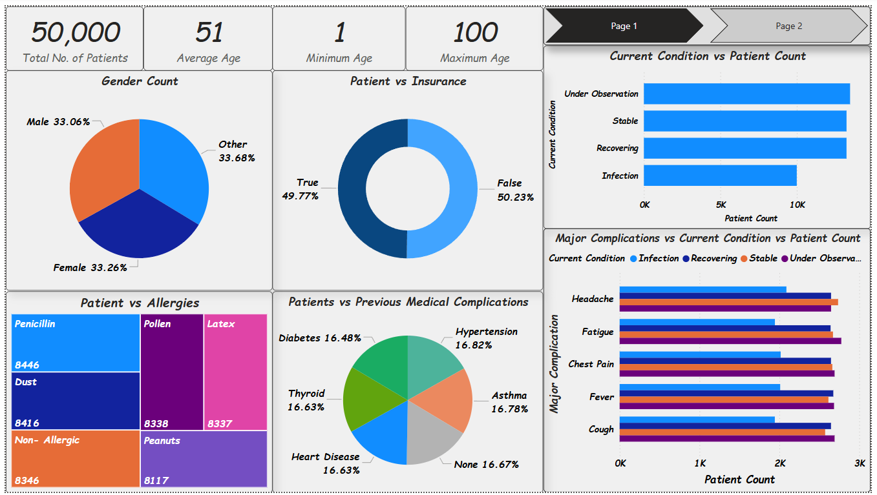

Slide 9
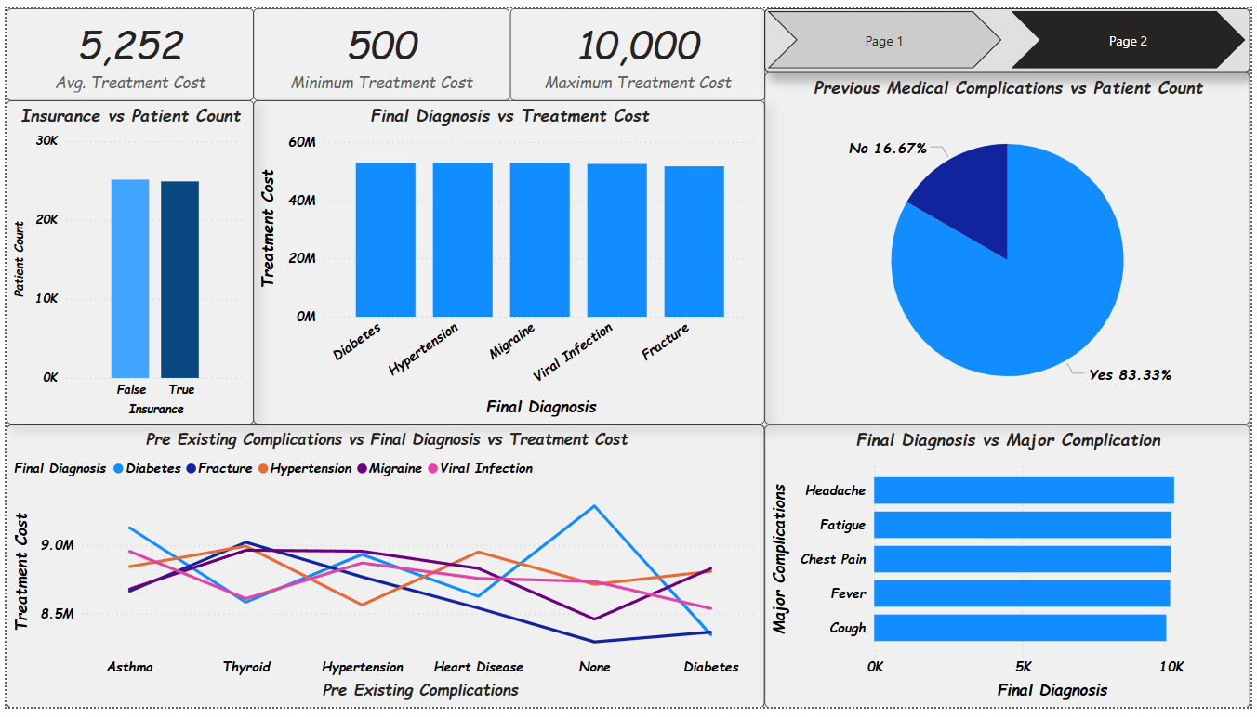

Slide 10
5. Problems/Challenges Faced
Handling Missing Data: Some fields like Contact, Insurance Provider, and Discharge Date contained NULL values. These had to be managed through replacement strategies.
Ensuring Data Integrity: Duplicate patient records were removed to maintain accuracy.
Complexity in Dashboard Visualization: Some relationships between conditions, treatments, and costs required advanced filtering and drill-through options for clarity.
Formatting Issues: Treatment cost was initially stored in different formats (some with "$" symbols), which required cleaning.

Slide 11
6. Outcome
A structured, validated, and cleansed patient dataset in PostgreSQL.
A fully interactive Power BI dashboard with clear insights into patient demographics, diagnoses, and financial aspects.
Better understanding of patient hospitalization trends and follow-up requirements.
Cost analysis based on insurance status, helping to optimize healthcare expenses.

Slide 12
7. Conclusion
This project successfully demonstrated how SQL & Power BI can be used together to validate, clean, and analyze patient data. The final dashboard provides actionable insights for healthcare professionals to improve patient care and cost management.

Slide 13
7. Topics Learned
✅ SQL Data Cleaning & Validation ✅ Power BI Dashboard Development ✅ Data Visualization Techniques ✅ Handling Missing & Inconsistent Data ✅ Healthcare Data Analysis & Decision Making

Slide 14
Thank You!!

